Slide 1


CC-Wiki Report : Milestone 2
Huajun Chen, Zhejiang University,
April 23, 2012, Seattle

Slide 2
Original Project Plan
M2: Jan.1, 2012-Apri. 30, 2012
M3: May. 1, 2012 - Jun. 30, 2012
M4: Jul.1, 2012 – Oct. 31, 2012
M1: Oct. 1, 2011-Dec. 31, 2011
A fast prototype for proof of the concept with major user interfaces.
Major component development finished with necessary documentation.
A prototype and beta-service with registered number of test users.
Public test finished with all software packages and documentation submitted.

Slide 3
Major Goal of M2
We need a full system implementation ready to internal test and beta-service.
Stable Architecture
Friendly UI
Enough Data Sources
Advanced Features

Slide 4
What We Have Achieved in M2
2. Full Implementation of the Semantic Features
Redesign the CC ontology and imported to SMW.
Implement a customized facet search engine (both UI and back-end, most challenging one).
1. Redesign the technical architecture.
With more consideration of Semantic features.
With more consideration of Wiki features.
With more straightforward and simpler workflow
We now support semantic-based content search for all pages.
We now support semantic-based filter for group-buying configuration.
Online data are mashuped semantically, imported and delivered as semantic data pages in SMW.

Slide 5
What We Have Achieved in M2
3. Largely expand mashuped contents
We now have 8 categories of templates.
A good number of data sources mashuped.
Tons of data pages are generated.
4. Rather friendly UI
Hot pages and page ranking.
Easy creation of new pages.
Page shortcut and fast access.
Redesign the face of all templates.

Slide 6
Design Principles
Everything is an (open) page.
Everything is on clouds.
SNS, Deals, Comments, Blogs…… CC is just a cloud bus
Keep things simple.
Simple UI, simple workflow, simple data…
Both data and UI are stored as wiki pages

Slide 7
Data Page vs UI Page
A data page is generated by the sMash engine.
A UI page is created by user based on certain templates.
SNS Data Pages
ASK Queries
Web
API
Deal Data Pages
UI Pages
ASK Queries
Blog Data Pages
……
ASK Queries
Page Templates
Other Data Pages

Slide 8
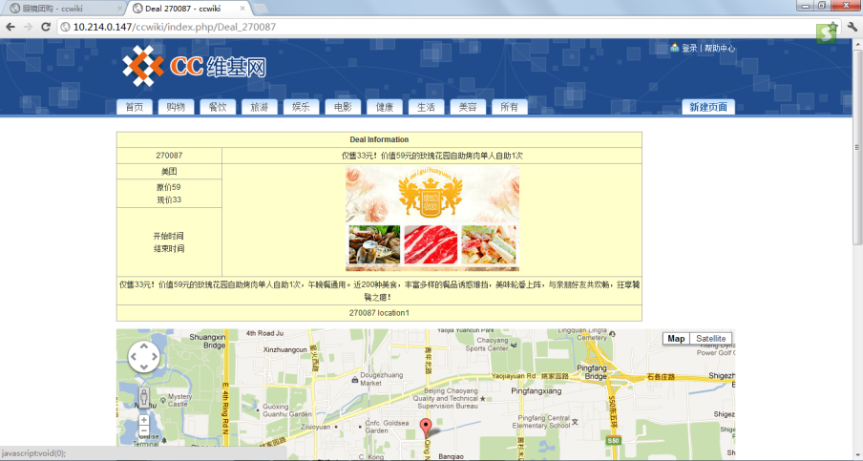
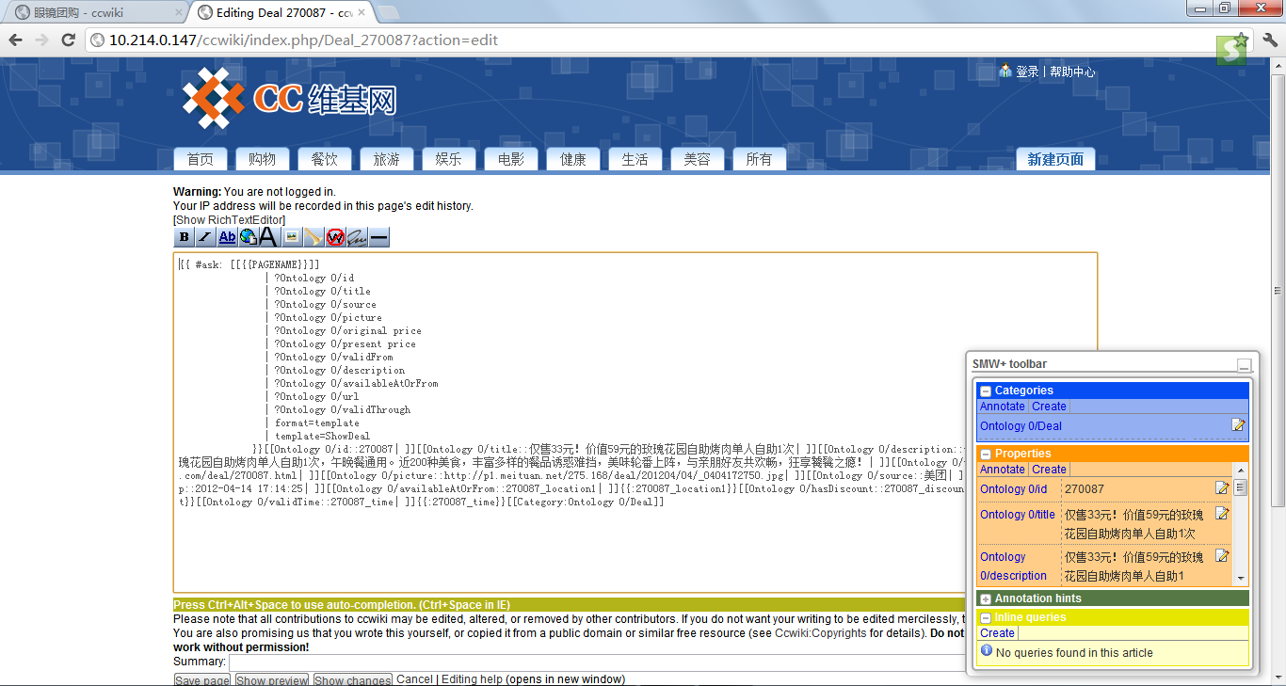
A Sample Data Page

Slide 9
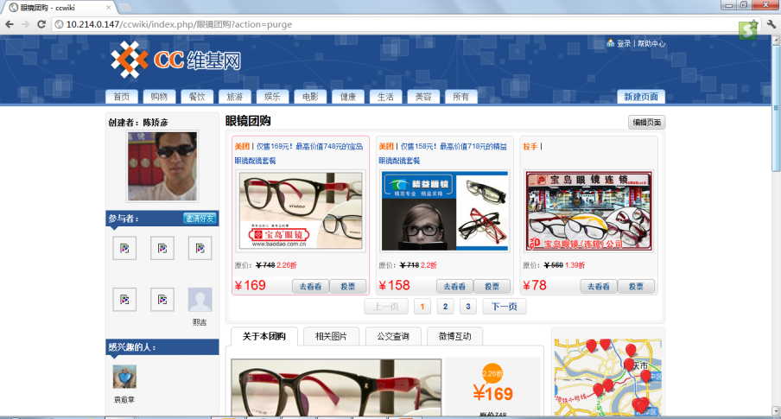
A Sample UI Page

Slide 10
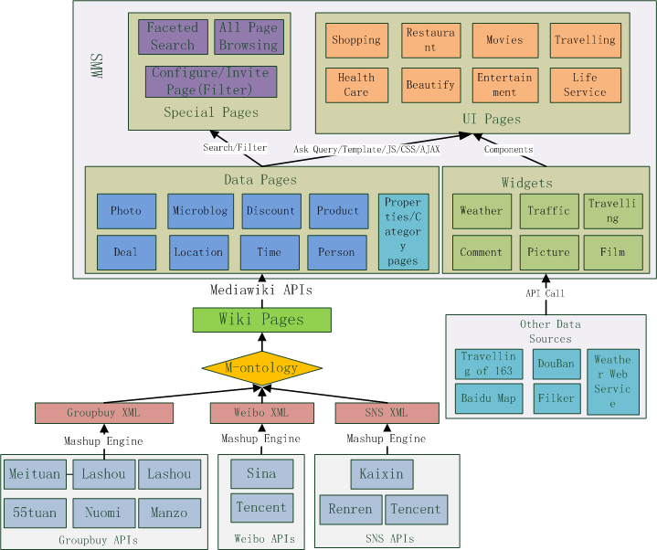
New Technical Architecture
All data pages and UI pages can be searched by a customized facet search engine.
UI pages retrieve data from data pages through “ASK Query”.
A UI page is typically comprised of several wiki widgets that control the display of the semantic data.
All data are imported to SMW as semantic data pages.
Each wiki widget is a kind of semantic result format that can control the display of semantic data.
All data are mapped to the ontology so that heterogeneous data can be merged.
Data are mashuped from online APIs.

Slide 11
New Data Sources
6 Groupbuy Data Sources: Meituan, Lashou, 55tuan, Nuomi, Ftuan, Manzo
2 Weibo Data Sources: Sina, Tencent
3 SNS Data Sources: Kaixin, Renren, Tencent
Others: Weather, Map and Traffic Information, Pictures from Filker , et
2 Travelling Data Sources: Travelling of 163, dili360
1 Film Data Source: Douban

Slide 12
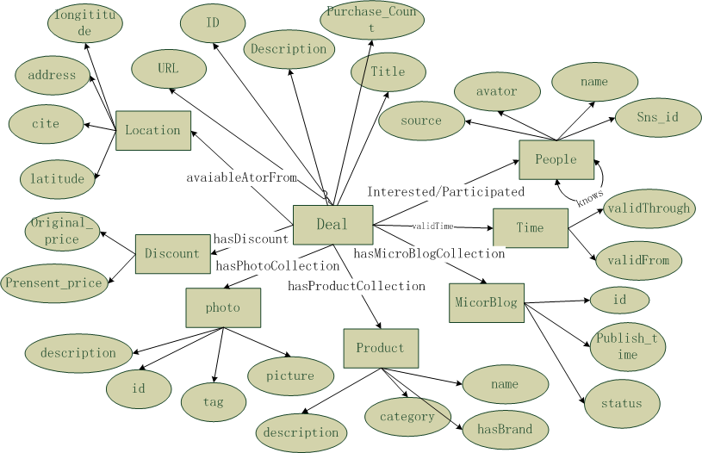
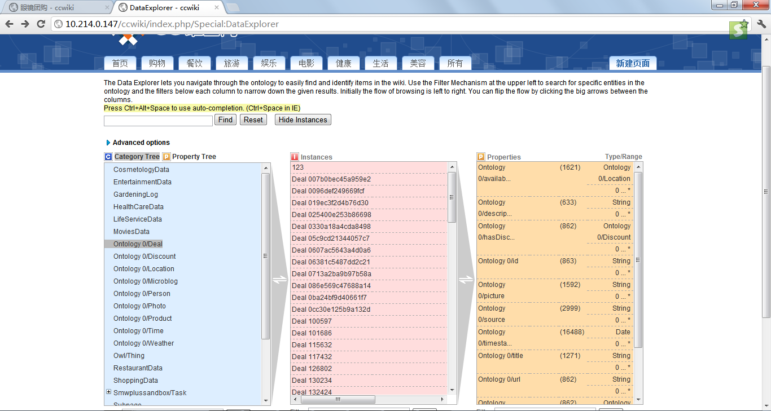
The CC Ontology
One category page is created for each class of the ontology

Slide 13
Technical details of Data pages
Role: Store all the mashuped semantic data, synchronized with online data.
Structure:
8 categories of data pages: Deal, Location, Discount, Photo, Product, People, Time, MicroBlog.
Deal acts as the “Main Page”, while the others act as the value pages of the properties in “Main Pages”
8 category pages, about 40 property pages, and numerous data pages
Import API
Translated to SMW format
Translated to RDF format
Mashup
Keyword Filter
SNS API
Deal API
Blog API
Other API

Slide 14
Technical details of UI pages
Categories
8 categories of UI pages: Restaurant, Shopping, Travelling, Movies, Health Care, Life Service, Beautify, Entertainment
Layout
Write our own mediawiki templates to control layout
Result Format
Take advantage of the existing result format
Develop our own result format according to requirement

Slide 15
Facet Search Implementation
Two places where we use facet searches
Search all UI pages.
Search all deal data pages while configuring group-buying.

Slide 16
The problem of current facet search
Does not support the search of content that is generated through ASK Queries.
CC needs to search the content of UI pages that are typically generated by a number of ASK queries.

Slide 17
Solution
For each UI page, we generate a corresponding data page (called UI-data-page) by executing those ASK quries of that UI page.
The facet search engine simply indexes these UI-data-pages. While users search a UI-data-page, they will be re-directed to the corresponding UI pages.
We then write a robot (like a search engine robot) to periodically execute those UI pages to update corresponding UI- data pages.

Slide 18
Live Demo

Slide 19
Major Goal of M3
Beta-service with registered number of test users.
Component Optimization
Incubate User Group in ZJU
Internal test users > 30
New Features

Slide 20
Look into the future (for both M3 and M4)
Make it to be more like a platform
Group buying is just one instance, we could develop new instance such as conference management.
English version for English users.
More advanced features:
Semantic Notification Feature
Semantic data analysis.
Historical data analysis and reasoning
Spatial data analysis and reasoning
Since we have so much semantically linked open data.

Slide 21




Thanks for your support!

